Slide 1
Analysis of Recycling trends in New York city
Group DC20078
Ashley Chung, Darrien Kramer, Everett Stenberg

Slide 2
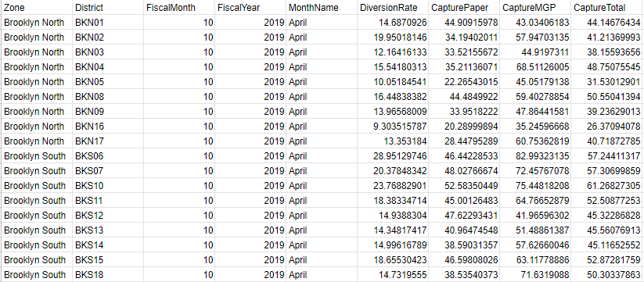
Data - Recycling Metrics
8233 Entries spanning 9 fields
Covers 2016 to 2019
7 Zones
59 Districts

Slide 3
Data - Recycling Metrics Explained
DiversionRate
Total amount of recycling diverted from the waste stream
CapturePaper
Percentage of paper diverted from the waste stream
CaptureMGP
Percentage of metal, glass, and plastic diverted from the waste stream
CaptureTotal
Percentage of recyclable material diverted from the waste stream

Slide 4
Problem Statement
What type of recycling is most common in different areas and what areas should be targeted for increased recycling efforts and education?

Slide 5
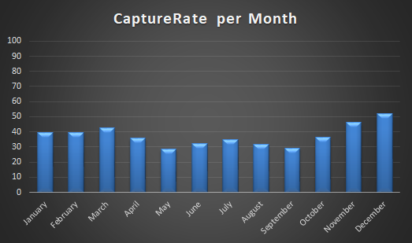
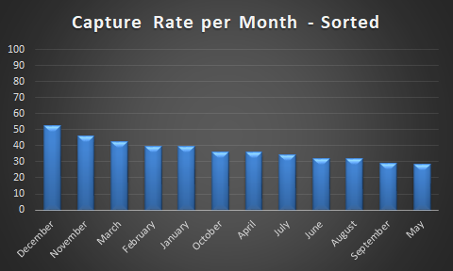
Recycling by Month
Patterns:
Winter, Spring - Higher
Fall,Summer - Lower

Slide 6
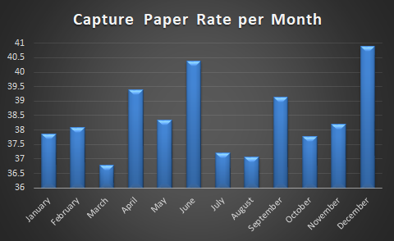
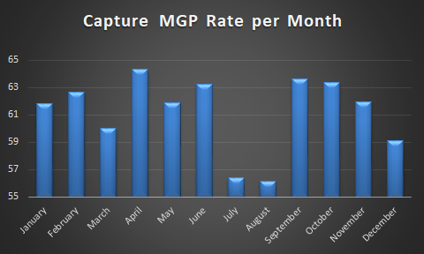
Predictive Analysis
Spring, Summer
Vacation - introduces fluctuations to sample

Slide 7
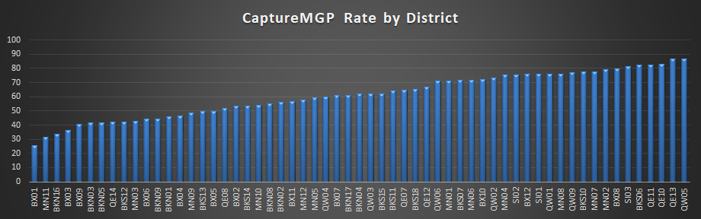
Recycling by Type - MGP

Slide 8
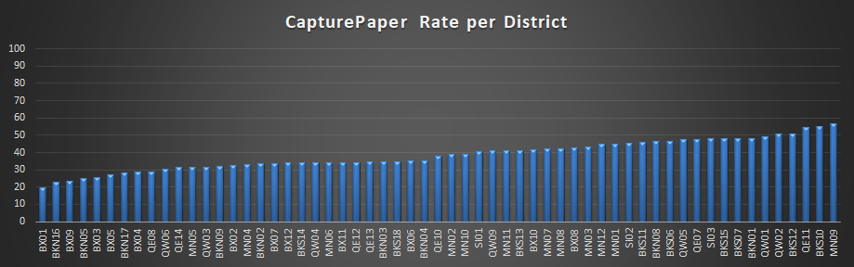
Recycling by Type - Paper

Slide 9
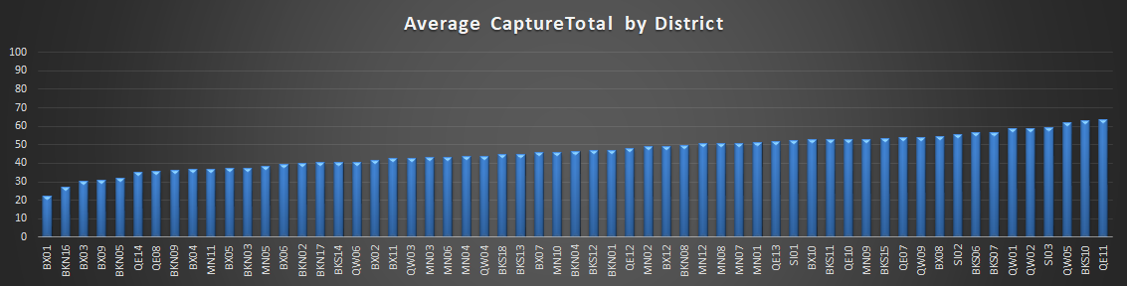
Recycling by Type - CaptureTotal

Slide 10
Analysis - Recycling Type - Top 10
Paper
MN09, BKS10, QE11, BKS12, QW02, QW01, BKN01, BKS07, BKS15, SI03
MGP
QW05, QE13, QE10, QE11, BKS06, SI03, BX08, MN02, MN07, BKS10
CaptureTotal
QE11, BKS10, QW05, SI03, QW02, QW01, BKS07, BKS06, SI02, BX08

Slide 11
Analysis - Recycling Type - Top 10
Paper
MN09, BKS10, QE11, BKS12, QW02, QW01, BKN01, BKS07, BKS15, SI03
MGP
QW05, QE13, QE10, QE11, BKS06, SI03, BX08, MN02, MN07, BKS10
CaptureTotal
QE11, BKS10, QW05, SI03, QW02, QW01, BKS07, BKS06, SI02, BX08

Slide 12
Analysis - Recycling Type - Bottom 10
Paper
BX01, BKN16, BX09, BKN05, BX03, BX05, BKN17, BX04, QE08, QW06
MGP
BX01, MN11, BKN16, BX03, BX09, BKN03, BKN05, QE14, QE14, BKS12, MN03
CaptureTotal
BX01, BKN16, BX03, BX09, BKN05, QE14, QE8, BKN09, BX04, MN11

Slide 13
Analysis - Recycling Type - Bottom 10
Paper
BX01, BKN16, BX09, BKN05, BX03, BX05, BKN17, BX04, QE08, QW06
MGP
BX01, MN11, BKN16, BX03, BX09, BKN03, BKN05, QE14, QE14, BKS12, MN03
CaptureTotal
BX01, BKN16, BX03, BX09, BKN05, QE14, QE8, BKN09, BX04, MN11

Slide 14
Predictive Analysis
Bronx
Low priority: lowest income levels
Manhattan
Huge population, central business district, highest income levels
Brooklyn North
Low priority: lower income levels

Slide 15
Machine Learning Predictions
Linear Regression
Predict CaptureTotal Rate - Score: -.02
Multilinear Regression
Predict CaptureTotal Rate - Score: .612
Random Forest Classifier
Predict CaptureTotal category- 76% Accuracy in category placement

Slide 16
Conclusions and steps going forward
Our predictive analysis and graphics allowed us to find trends and identify areas of concentration for education and improved recycling efforts.
Areas of Effort
Bronx
Brooklyn North

